Slide 1
MY VERY FIRST PORTFOLIO
“This is just the beginning of something big.”

Slide 2
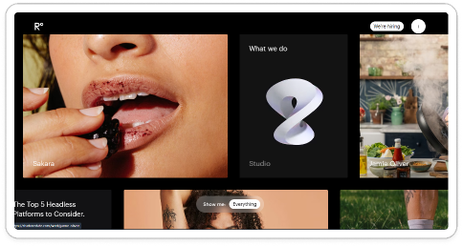
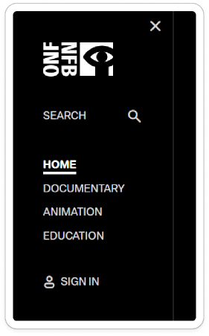
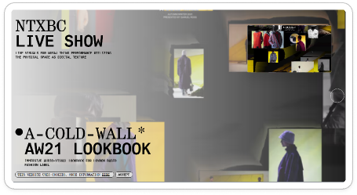
Concept & Structure
minimalism monochrome logo
layout in each works
bento grid
scroll effect: when scroll down, image scroll horizontally based on scroll down vertically

Slide 3
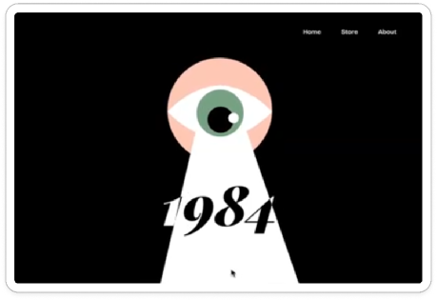
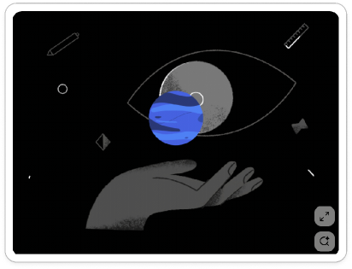

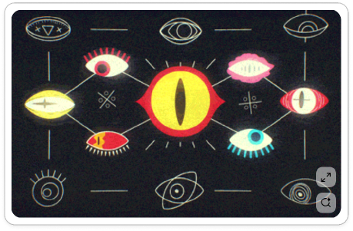
Landing page moodboard

Slide 4

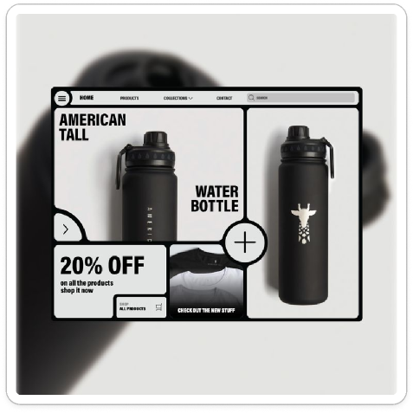
About section moodboard
bento layout

Slide 5
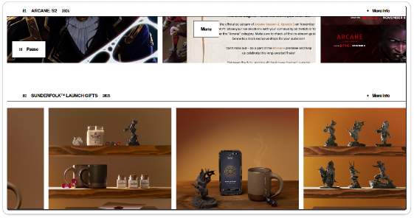
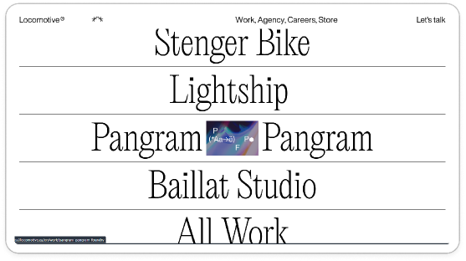
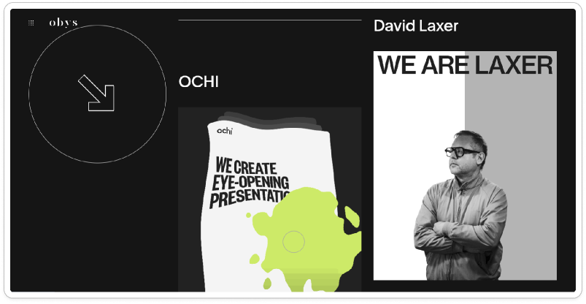
Project section moodboard

Slide 6
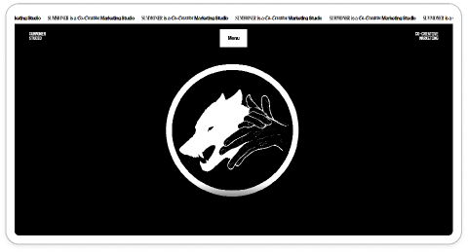
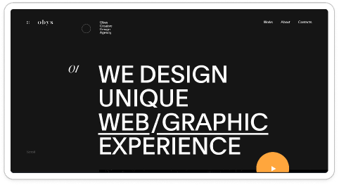
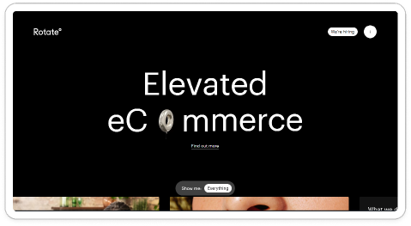
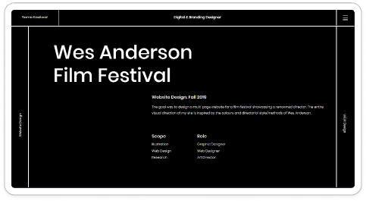
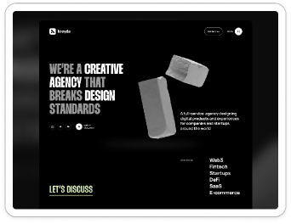
Moodboard

Slide 7
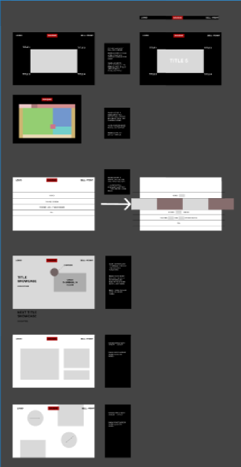

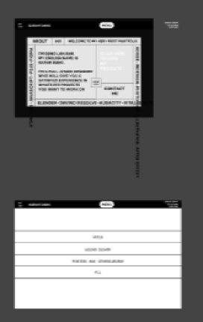
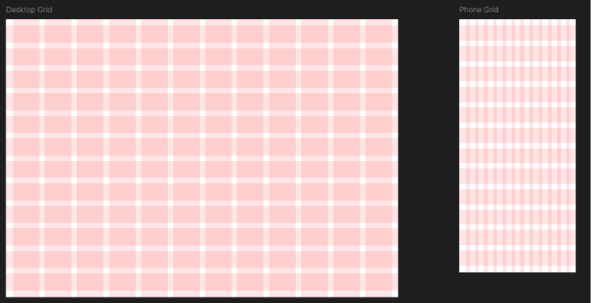
Figma low and mid fidelity
Link to my figjam: https://www.figma.com/board/XoZee6UgooA6tnr4D2DJXP/Interactive-asm-2?node-id=0-1&t=kxz5bzwcwP0UvbZC-1
Link to my figma: https://www.figma.com/design/YPgBbdzaJvSrMMlQJZ7qJt/interactive-asm2?node-id=0-1&t=9UJF5J2CvkNEgBmG-1
Original nav-bar design

Slide 8
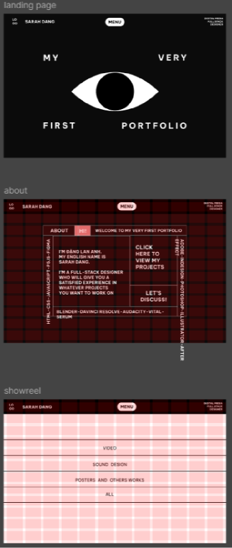
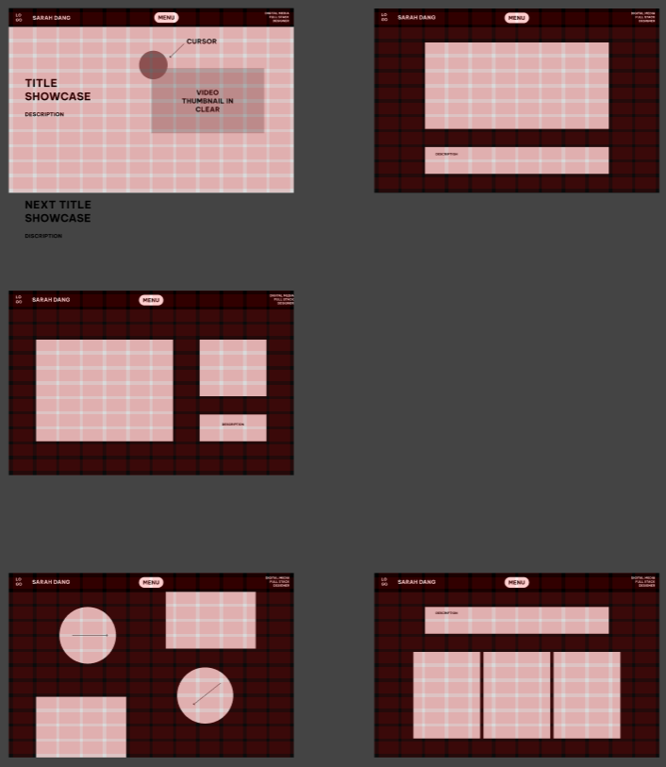
Figma high fidelity

Slide 9
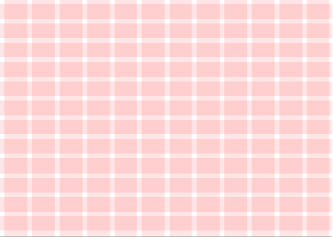
Design system:
background-color: #ff9424
background-color-2: #faf2d1
main-color: #0b0b0b
font-color-2: #0b0b0b#ffffff
grid large screen: row-12; column-12
grid small screen:
font: Montserrat

Slide 10
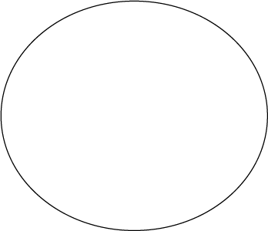
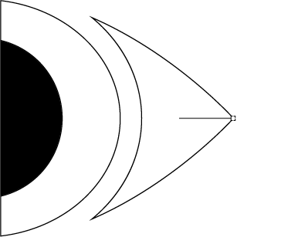
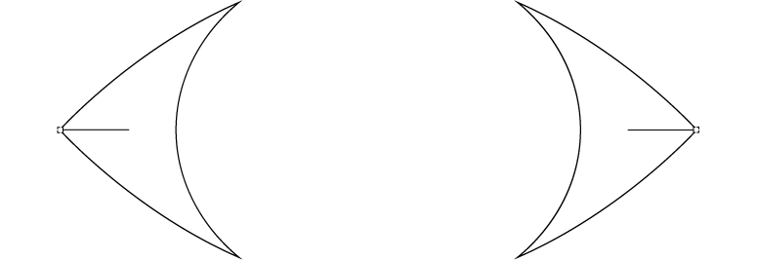

My element
This element is made with the thought of combining the eye, eye isis, and the pen’s nib. The end of the nib is the editing point when we want to change the form of a line or more.

Slide 11
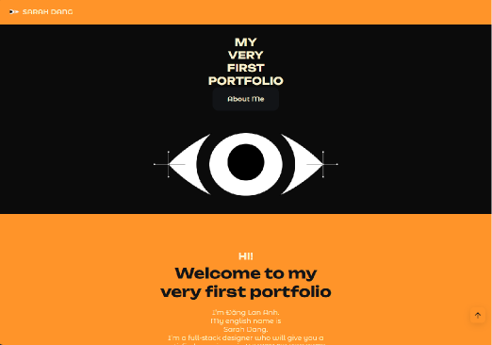
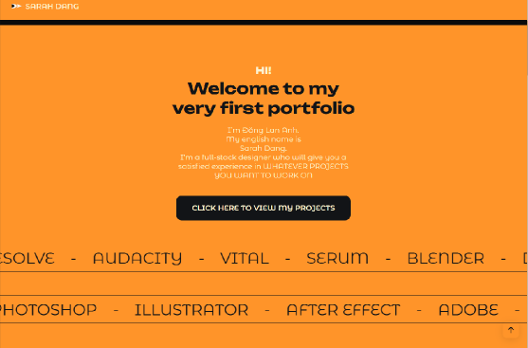
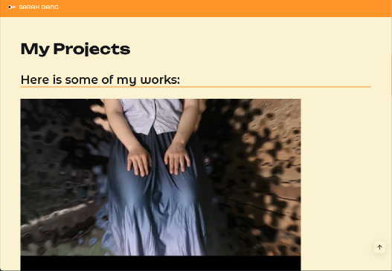
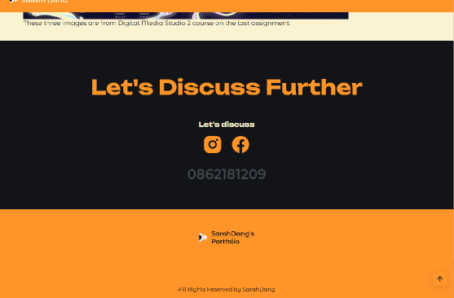
My website outcome

Slide 12
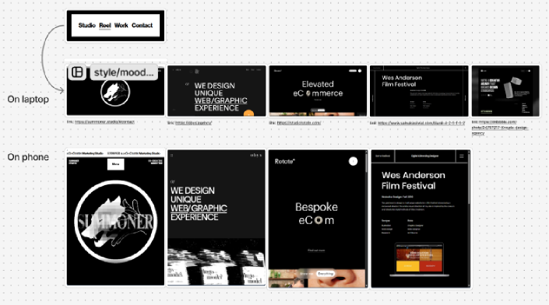
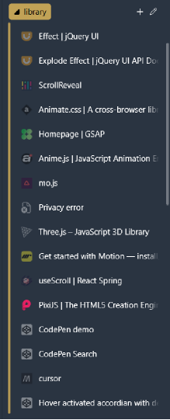
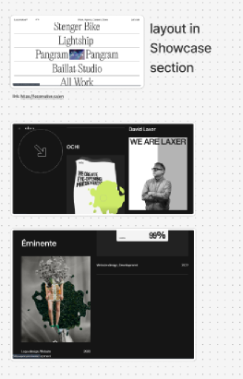
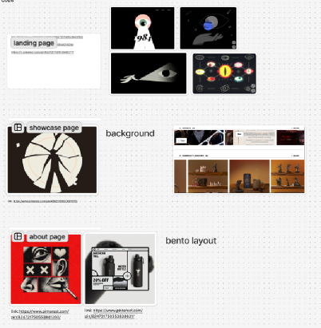
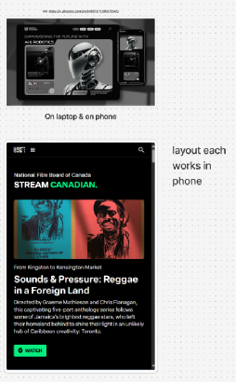
Reflection
Orginially, I have a lot of things I want to put in my website.
There were many
things I want to
try out, as you can
see I already mark
these pages with full
of interactive and
animation effect.

Slide 13
Reflect
However, I soon realize that my resources and my capability are limited. So in a short time, I finish this with my backup emergency (as in one of my draft idea that I made as first but did not choose it since the color palette did not match well with the concept I was planning) combining with my original idea, to the best of my possibility.

Slide 14
Citation:
Adi, Yazan. “Futuristic Design: AI & Robotics Website.” Pinterest, 24 Dec. 2024, in.pinterest.com/pin/845973111290870945/. Accessed 31 Aug. 2025.
“Bento Ui.” Pinterest, 2 Aug. 2025, www.pinterest.com/pin/824721750553838631/. Accessed 31 Aug. 2025.priority_highWebpage authorclose
“Blocked Page.” Pinterest.com, 2025, www.pinterest.com/pin/824721750553841260/. Accessed 31 Aug. 2025.priority_highWebpage authorclose
“Bureau Cool.” Bureau.cool, 2020, bureau.cool/.priority_highWebpage authorclose
“Headless Commerce Agency - Rotate° - ECommerce Agency London.” Rotate°, 6 Apr. 2025, studiorotate.com/. Accessed 31 Aug. 2025.priority_highWebpage authorclose
“Illustration Learning.” Pinterest, 7 Aug. 2025, www.pinterest.com/pin/824721750553943763/. Accessed 31 Aug. 2025.priority_highWebpage authorclose
“Locomotive — Montreal Web Agency.” Locomotive, locomotive.ca/en.priority_highWebpage authorclosepriority_highDate publishedclose
“Motion Graphs.” Pinterest, 7 Aug. 2025, in.pinterest.com/pin/824721750553946377/. Accessed 31 Aug. 2025.priority_highWebpage authorclose
“Obys Agency.” Obys, obys.agency/.priority_highWebpage authorclosepriority_highDate publishedclose
Simbaña, Allison. “Transformation Concept Art.” Pinterest, 21 July 2025, www.pinterest.com/pin/49821139623691995/. Accessed 31 Aug. 2025.
“SUMMONER.” Summoner.studio, summoner, 2025, summoner.studio/#contact. Accessed 31 Aug. 2025.priority_highWebpage authorclose
“Wes Anderson | My Portfolio.” My Portfolio, 2019, www.samakasliwal.com/blank-4-2-1-1-1-2. Accessed 31 Aug. 2025.priority_highWebpage authorclose
“Zetetics: Content Production.” Pinterest, 14 Aug. 2025, in.pinterest.com/pin/824721750554074326/. Accessed 31 Aug. 2025.

